Slide 1
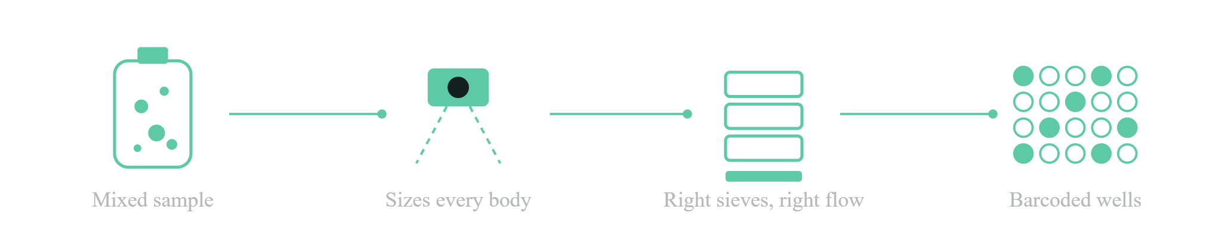
Bags in, barcodes out
Hackathon pitch
From digital twin to physical objects, every step under chain of custody · BioKEA Track A
BaeBugs · BioKEA Track A
Notes:
0:00-0:25. Sample prep is the bottleneck: separating specimens from debris by size, by hand. Our system looks first, then decides which sieves to use. Bags in, barcodes out.

Slide 2
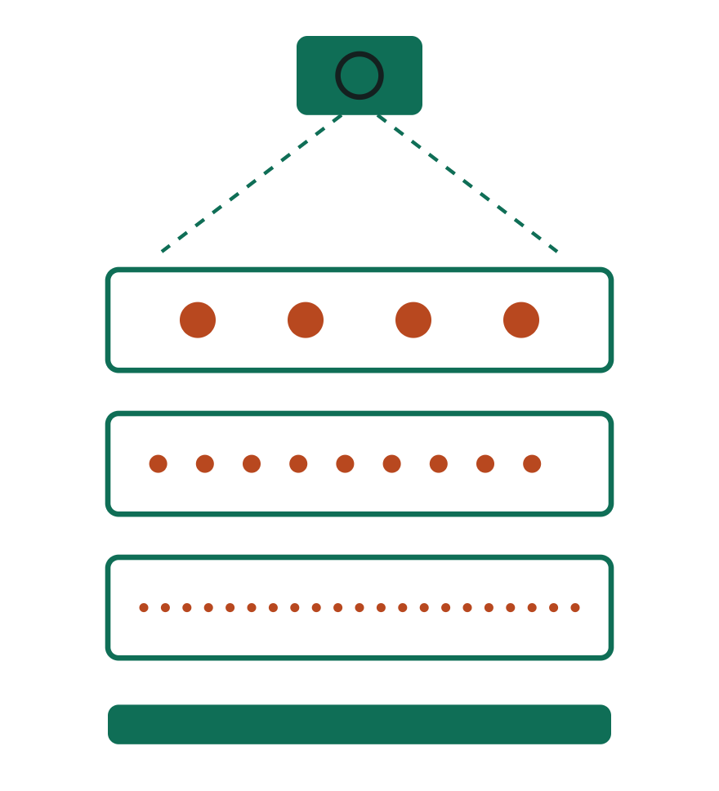
Sort a mixed sample with no manual sieving
Design intent
Camera measures the sample and picks the sieve sizes
Robot arm builds the stack and handles every tray
Loop of shake, image and check until each layer is pure
Clean layers delivered to scientists in collection boxes
BaeBugs · BioKEA Track A

Slide 3
Six steps, each one checked
How it works
01
02
03
04
05
06
Observe
Hypothesize
Preflight
Run
Verify
Hand off
Camera and two sizers measure every body
Pick sieve stack and water flow
Digital twin must pass
Arm places sieves, water rinses
Image each fraction, update margin
Files for BugPicker, then wells
Every step is written to a hash-chained provenance log, per sample
BaeBugs · BioKEA Track A
Notes:
0:25-1:05. Six stages: observe, hypothesize, preflight, run, verify, hand off. Teal steps are software, orange steps move hardware. Each step is logged so a result can be traced back to the exact sample and parameters.

Slide 4
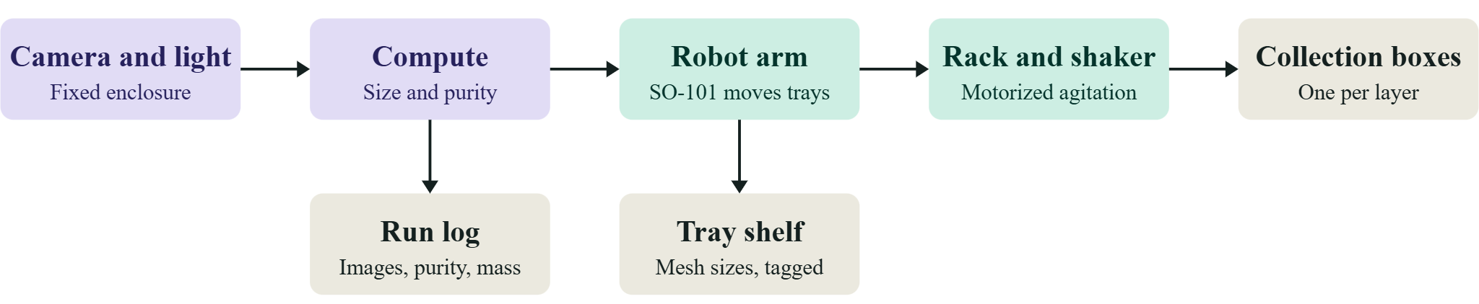
System architecture
Design intent
BaeBugs · BioKEA Track A

Slide 5
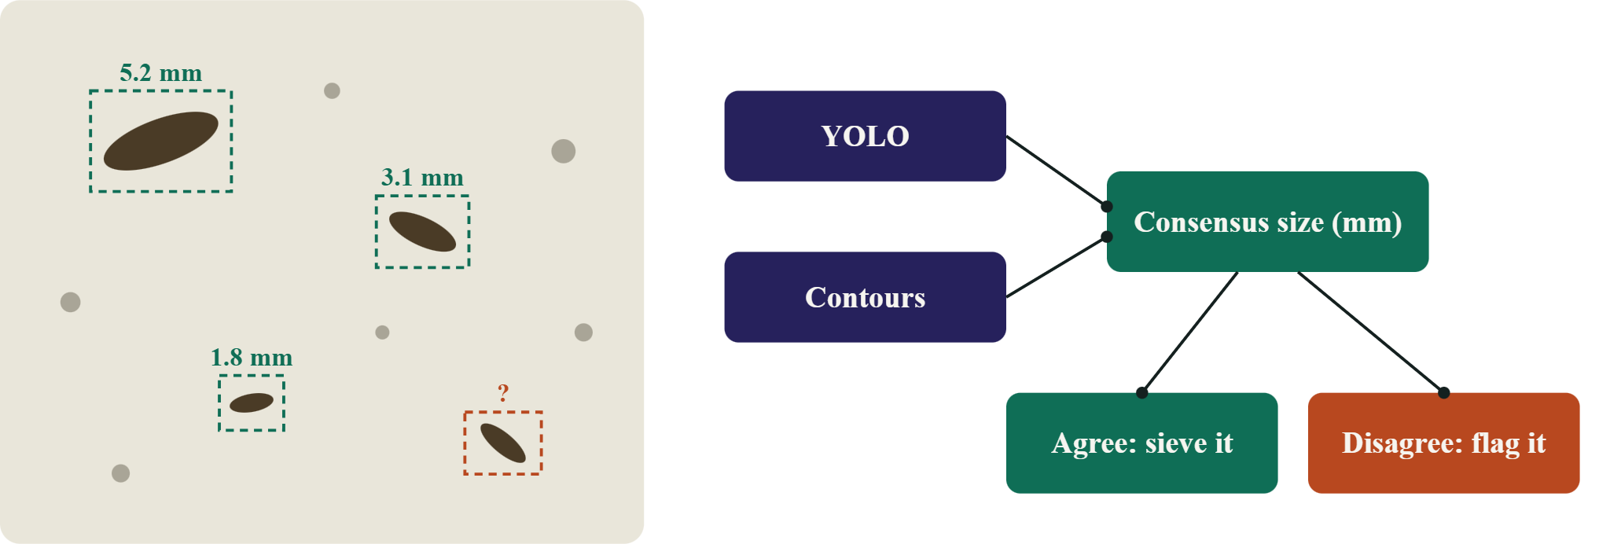
Two sizers must agree
Observe
BaeBugs · BioKEA Track A
Notes:
1:05-1:40. A USB camera with a printed scale marker measures every body in millimetres. YOLO and classical contours fail in different ways, so we only act on sizes both agree on. Disagreements are flagged instead of sieved blind.

Slide 6
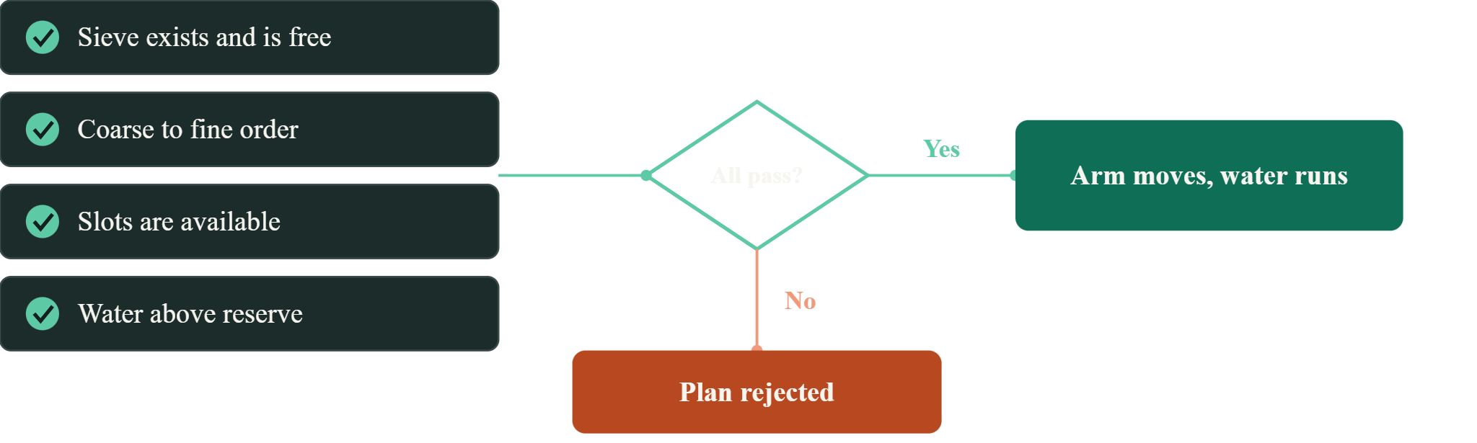
Fail closed before hardware moves
Preflight
BaeBugs · BioKEA Track A
Notes:
1:40-2:10. Before anything reaches the arm, a digital twin of the bench checks that the sieve exists and is free, the order is coarse to fine, slots are open and there is enough water. If any check fails, nothing moves.

Slide 7
Digital to physical, one custody graph
Full lab stack
Filters: 32 hole types on one 50 mm plate (16 punched, 4 bought, 12 stainless)
Plastic is the frame, metal is the aperture: 100 mm inserts and a 316L variable-aperture stage
Vision at each handoff: YOLOE, OWLv2, the order classifier and a local VLM (qwen2.5vl:3b)
Local models: 2,627 crops split by source photo feed small per-taxon preprocessors
91 printable PA12 toy insects, 1.0 to 29.9 mm, across 13 body plans
8 MIT labware remixes with Opentrons definitions, about $8.40 of filament
Protocol Board: pin, run, remix or contest any protocol; every card points at exact bytes
BaeBugs · BioKEA Track A

Slide 8
Built in two days: the full stack
Oct 24 to 25 · 489 commits · 31 PRs
Physical
Digital
91 printed bug toys to train and test models
Models also tested on toys and food
Wood tower built by Wei, who also ran the printer
Repurposed metal cut to fit robot trays
SO-101 robot arm tested (PR #24)
Two camera lanes: Andrew and Byron
MCP server, CLI, three Vercel web apps
Trained on an M1 Mac, 3 local preprocessors
Python packages, datasets, deep research
Custody graph: 1,175 leaves, 25 breaks
Protocol Board, labware twin, demo reel
32 filters built for future runs
Repo record: 275 commits on Oct 24 and 214 on Oct 25, across PRs #1 to #31
BaeBugs · BioKEA Track A

Slide 9
25 breaks recorded, not hidden
Chain of custody
Rule: every hash the graph references must resolve to stored bytes, otherwise it is a BREAK
1,175 hashed leaves in one graph pack, with 7 append-only MMR logs
8 results whose trained weights were never stored stay exploratory
16 bench photos and 1 bench source are pinned by hash but withheld (rights not established)
Anyone can re-hash a file in the browser and contest a leaf as a GitHub issue
The same pack feeds the web page, CLI, MCP server and npx
BaeBugs · BioKEA Track A

Slide 10
Deciding when a tray is done
Design intent
Purity per tray
Pass rule
Stop and flag
Target objects divided by all objects in the tray image
Target purity set from calibration runs on labelled trays; not measured yet
Cycle cap set at calibration; a failed gate is logged as a BREAK, then human review
BaeBugs · BioKEA Track A

Slide 11
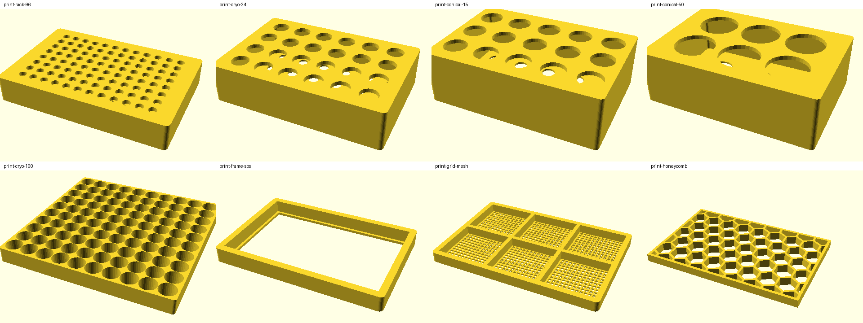
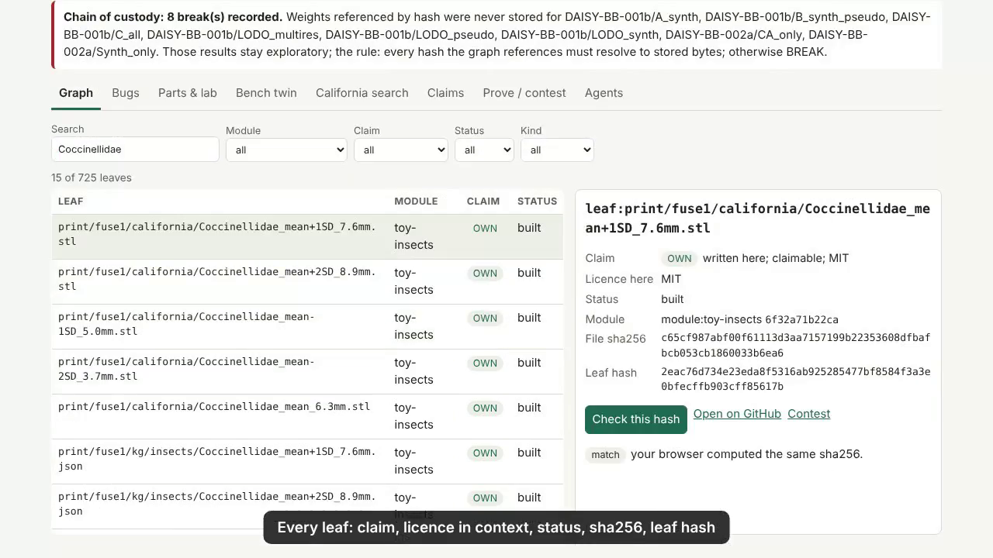
What we achieved
Outcome
Software end to end: sizing, sieve planning, twin preflight, custody graph, BugPicker files
Real CA photos beat synthetic-only out of state: +0.696 Arizona, +0.521 Oregon (mask mAP50-95, exploratory)
Order router outside California: macro-F1 0.70 vs 0.135 baseline, top-1 0.95 (n=231), weights stored
Live: MVP graph and Protocol Board; physical cycle time not yet measured
BaeBugs · BioKEA Track A

Slide 12
What we learned
Outcome
Hole shape matters: bodies lying flat pass round holes only near 0.6 to 0.7 of the diameter, so most pass end-on
FDM PLA and PETG failed on the perforated trommel, so apertures moved to metal inserts in plastic frames
The order model called bare floor Lepidoptera at 0.998: photo-vs-render checks come next
Hymenoptera family model falls from 0.88 to 0.17 out of state, so it hands off rather than decides
A kernel bug lost 8 runs of weights; weights are now hashed every epoch and checked fail-closed
BaeBugs · BioKEA Track A

Slide 13
Future work
Outcome
Calibrate the variable-aperture stage and measure real mesh apertures
Validate purity against hand-sorted or weighed trays; motorized shaker with the arm moving trays
Species-level preprocessors, distilled to local models
BioKEA novel-bug finder on Hugging Face
Preprint on the custody method with a Heterodox Labs-style use case
BaeBugs · BioKEA Track A

Slide 14
Built today, next on the bench
Status
Built
Next
Camera sizing in mm, vision at each handoff
Sieve planner, 32 filters, aperture stage
Digital twin preflight and labware twin
Custody graph, Protocol Board, MCP server
91 toys and 8 labware remixes, MIT
Drive the SO-101 arm and sieves
Measure real apertures
Close the loop on printed toys
Collect real damage data
Ask: bench time on a real BugSorter run and labelled trays to calibrate purity, plus museum partners for species-level data
BaeBugs · BioKEA Track A
Notes:
2:10-3:00. Be honest: the sizing, planning, twin, provenance and handoff are built. Closing the loop on real hardware, measuring real apertures and training on bug analogs are next. Finish with your ask.

